Slide 1


ENJOY CODING, A.I., ROBOTICS & SO MUCH MORE!

Slide 2
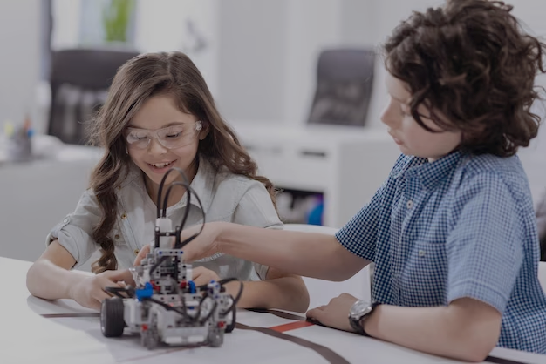

Learning With Us Is Always Fun!
State-of-Art Coding
Futuristic Concepts of AI
Hands on IoT & Robotics
Magical Tricks of Maths
Eloquent Communication

Slide 3

Cool Hacks from Avishek Sir to Show Off at School!
Vedic Math
Solving Real World Problems
Visualization Is Crucial
Healthy Brain Function
Avishek Adhikari
100/100 in Maths at both 10th and 12th boards
Cracked IIT JEE
Topper at both BSc & MSc, CU
Research Scholar at ISI
8 years of teaching experience
Friendly and empathetic

Slide 4

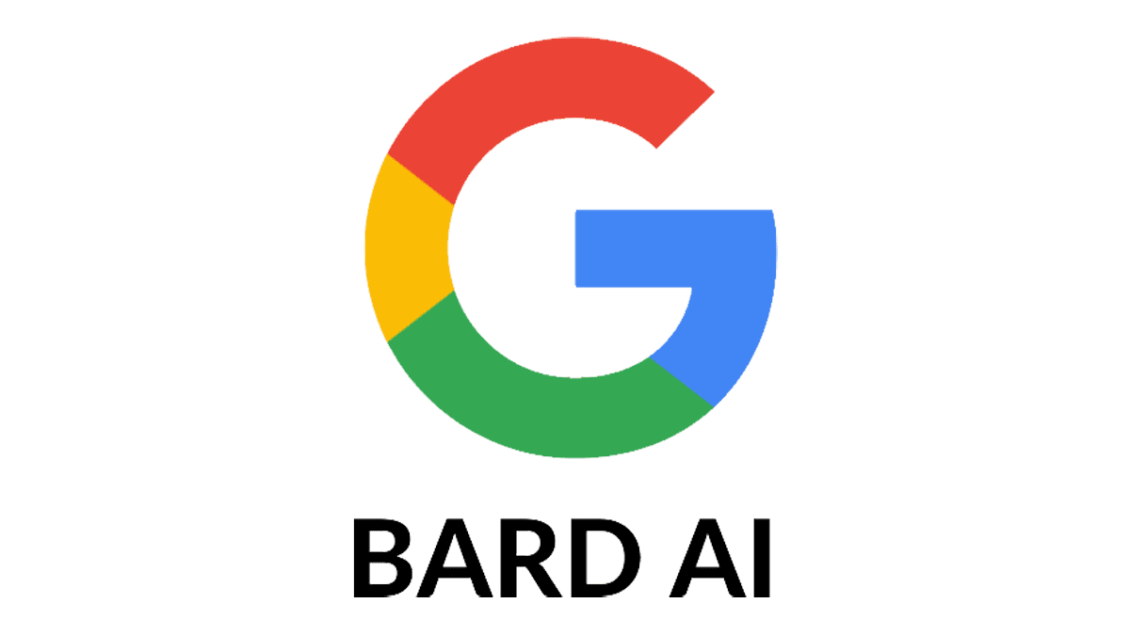




A Sneak Peek Down Alice’s Rabbit Hole
Like to try out yourself?
Creativity
Machine Learning
Mathematics
Neural Networks
Statistics
Deep Learning
Coding
Data Science
Anirban Chakrabarty
B.E. Electronics, M.B.A. Finance
24 years into IT, Corporate grooming & AI
Innovative, passionate & adventurous
Compassionate, father of 3 beautiful daughters!

Slide 5
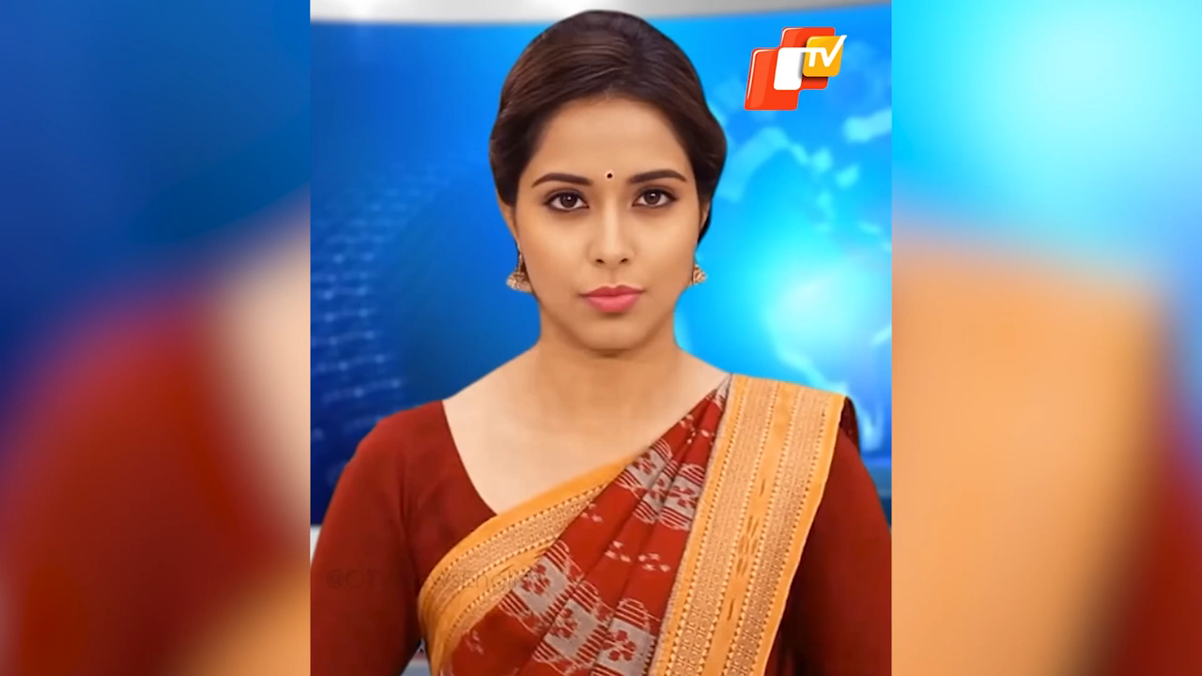
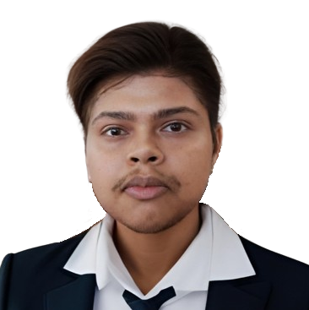
Meet Lisa, the Ghost News Reader!
Sayan Basak
Electrical Engg. (B.Tech)
Knowledgeable and passionate
Experience in Automation Industry
Compassionate, helpful & cheerful!
P.S.: Sayan sir has lots more on him. Insist for few other cool stuffs. Don’t let him go!

Slide 6
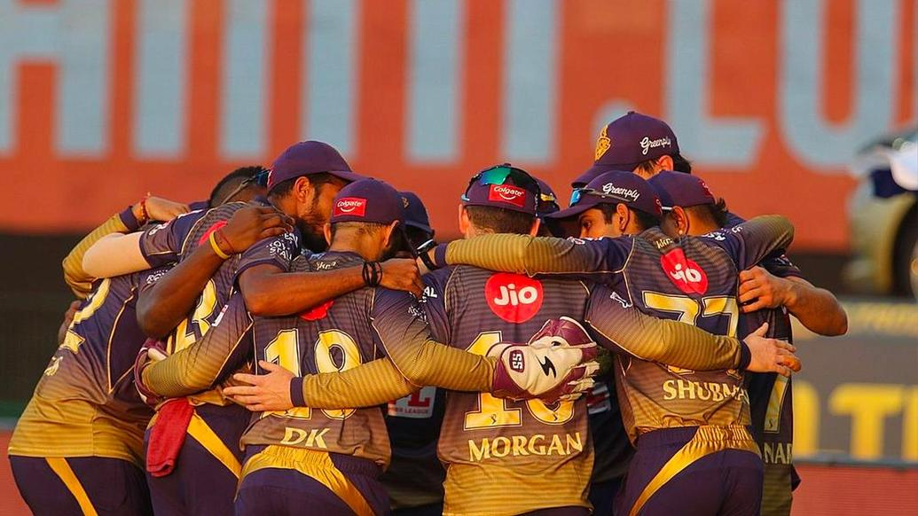

You Are in a Team Sport, Communication Is Key
Teamwork
Leadership
Confidence
Social Integration
Empathy
Corporate Etiquettes
Interview & Presentation Skills
Rahul Dutta
M.A., D.R.S. (English) - C.U.
English mentor since last 8 years
Specialist in contemporary comms skills
Mentors like an elder brother!

Slide 7
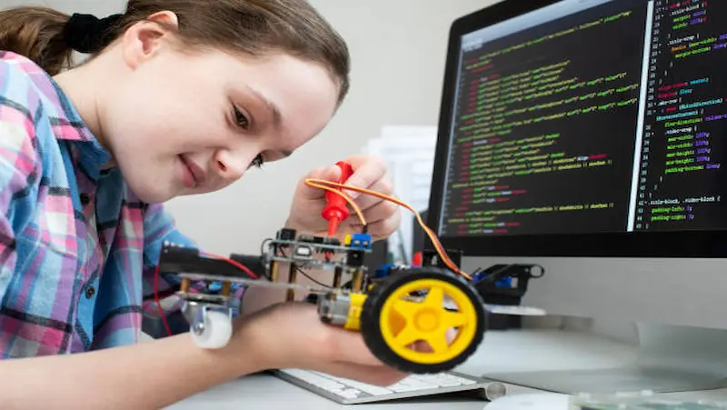

Your Play Time with IoT, Robotics & Bappaditya Sir!
STEM Concepts
Creativity
Problem Solving
Tech Competitiveness
Coding Logic
Bappaditya Debsingha
BE Mechanical (JU), MBA (XLRI)
Manager, TCS, 18 years of global experience
Taught Robotics to hundreds of kids
Father of a wonderful son!

Slide 8



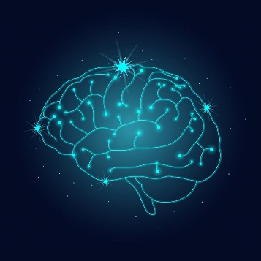




Almost Illicit Tips for Parents!
AI Professionals are globally the highest paid ones
Job satisfaction is extremely high
It is the inevitable future
Global crisis of good teachers
Anodiam is on a mission

